Slide 1
Mid-Point Project Presentation
Social Modifications
Keith Feeney
15015556
17 December 2018

Slide 2
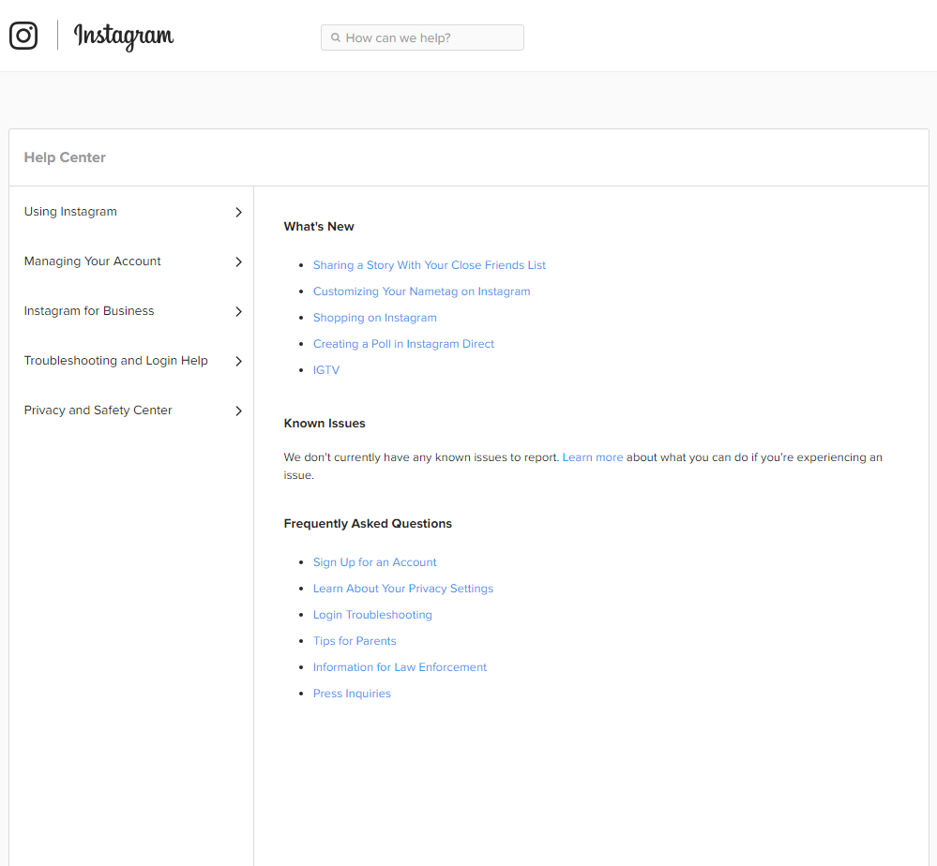
Introduction
Keith Feeney
Final year student at NCI
Social Modifications
Web Application & Android app
People over 18
Tattoos & piercings (modified people)
Help sections on social media
Artificial Intelligence
(Instagram, 2018)

Slide 3
Project Goals
Creating a web application & Android app
Research show little social networks for modified people
Help sections on current social networks
Artificial Intelligence
People aged 18 to 35 who have an interest in tattoos

Slide 4
Technologies to be used
Web application:
NetBeans
Maven (build automation tool)
Java
Web technologies like HTML, JavaScript & XML
Android app:
Android Studio
C++
XML
Other standard Android technologies
Google Firebase:
Database
File Storage

Slide 5
Requirements
Functional:
Create/Edit Profile
Update/Delete media
Send message
Group chat
Chat with ChatBot (Help section)
Rate Tattoo Shops
Non-functional:
Performance/Response time
Availability
Recoverability
Security
Usability

Slide 6
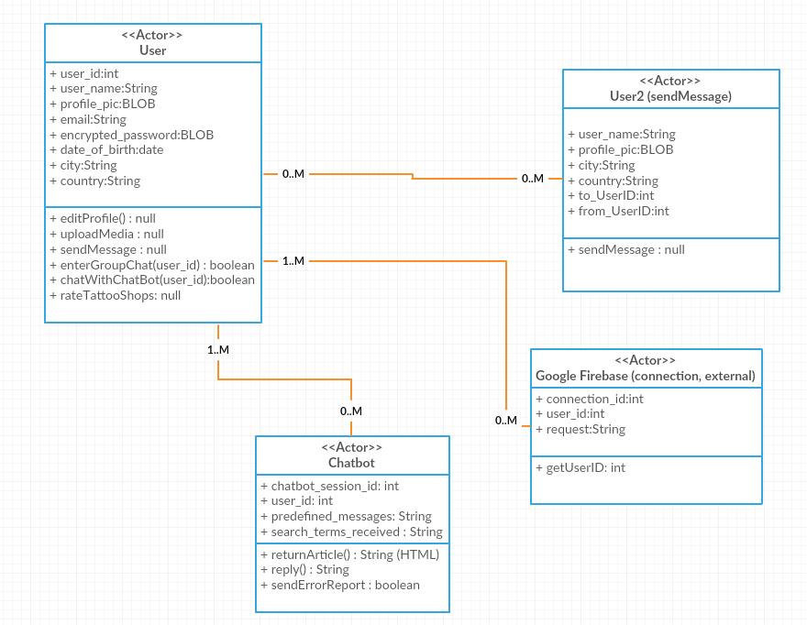
Architecture

Slide 7
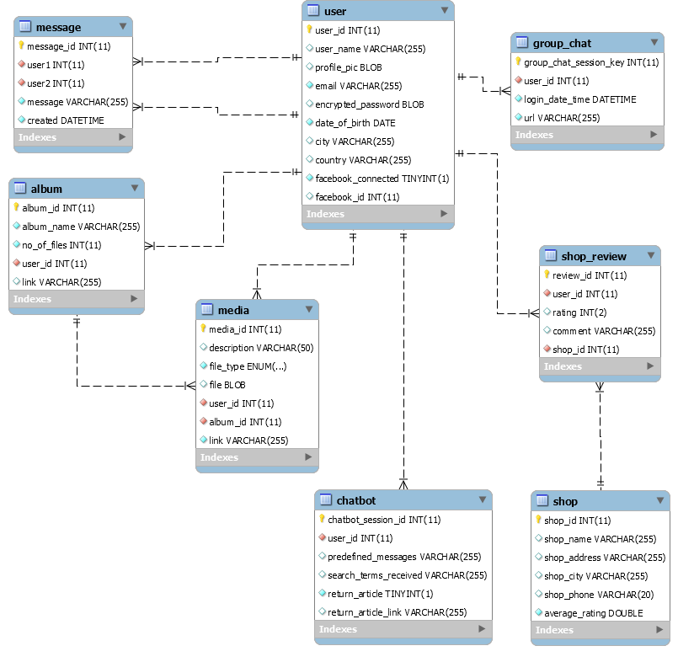
Database

Slide 8
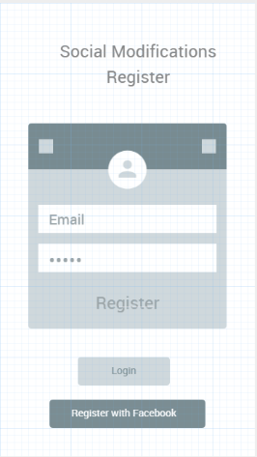
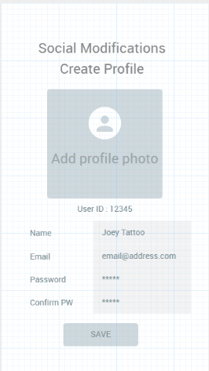
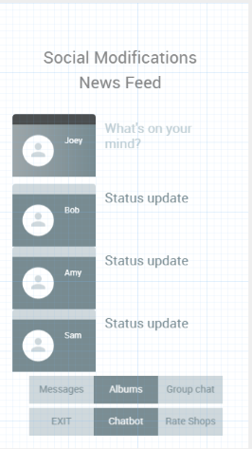
GUI

Slide 9
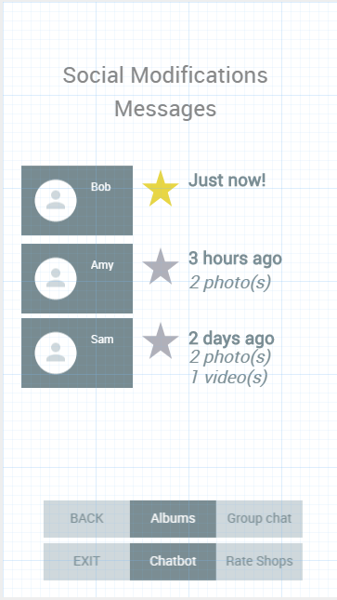
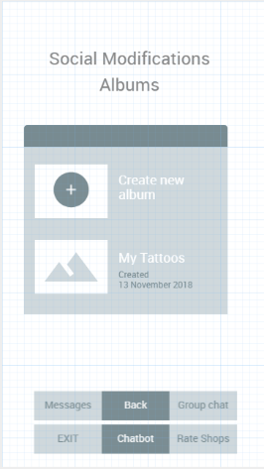
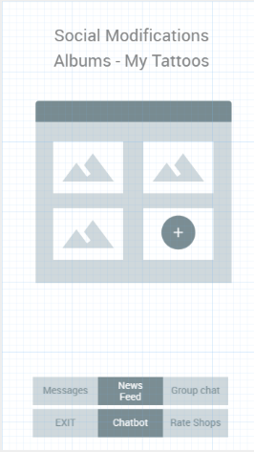
GUI

Slide 10
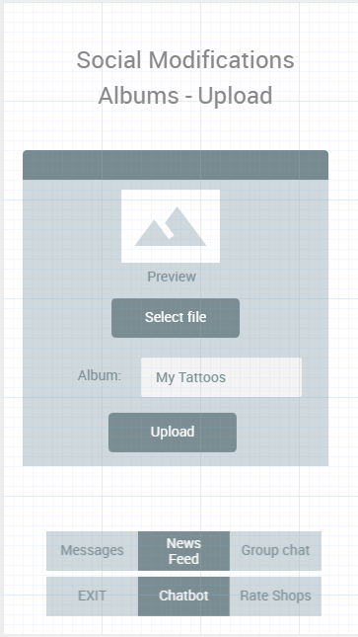
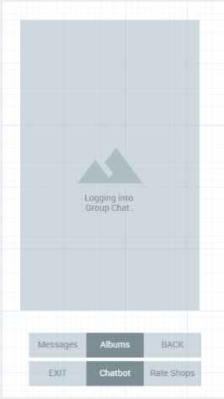
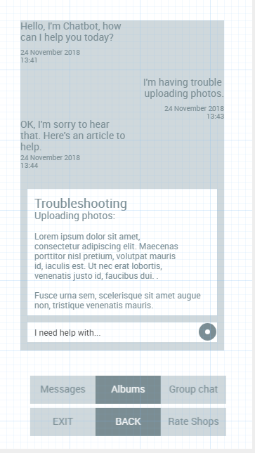
GUI

Slide 11
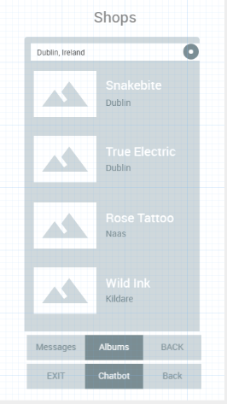
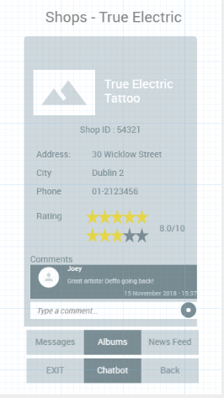
GUI

Slide 12
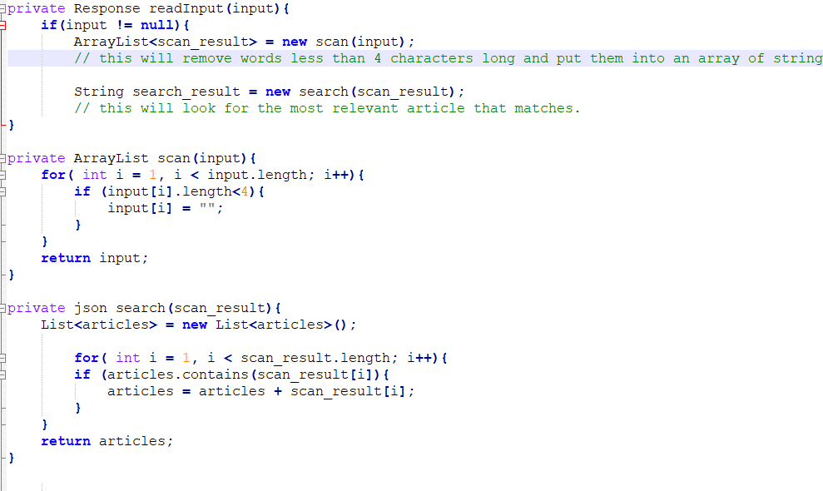
Example code for the ChatBot

Slide 13
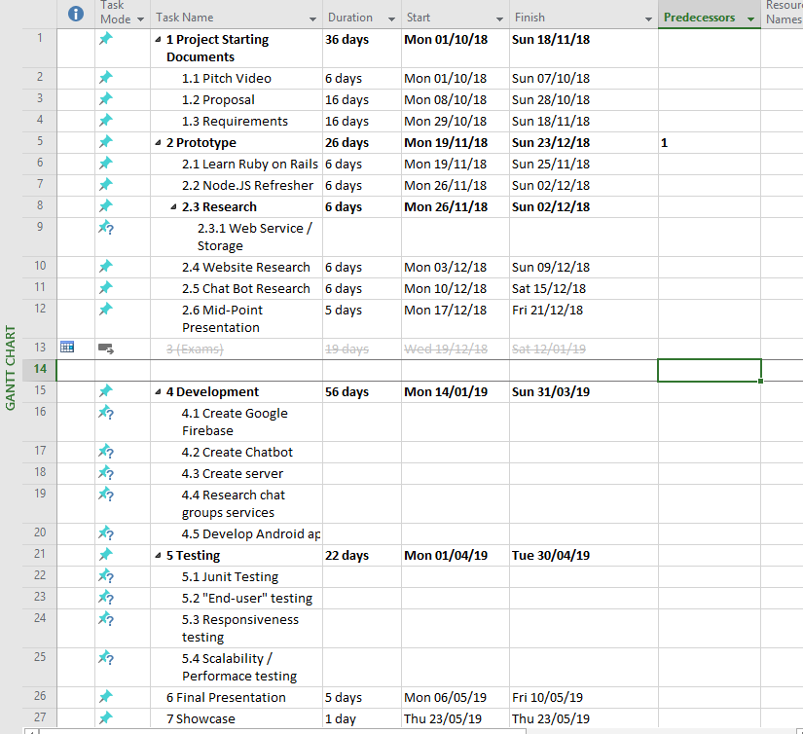
Where the Project is now

Slide 14
Conclusion
Where the Project is currently at
Difficulties
Evaluation
Result
Continuation

Slide 15
Questions
?

